Slide 1
Little is much: bridging cross-platform behaviors through overlapped crowds
Meng Jiang (Office 2130SC), Peng Cui (Tsinghua U),
Nicholas Jing Yuan (MSRA), Xing Xie (MSRA),
Shiqiang Yang (Tsinghua U)
cross-platform behavior prediction
AAAI-16 THIRTIETH AAAI CONFERENCE ON ARTIFICIAL INTELLIGENCE
Notes:
Download slides from our website.

Slide 2

We Need Multiple Platforms

Slide 3

Cross-Platform: e.g., Facebook+App

Slide 4
Behavior Prediction
Predict missing entries in behavioral data
Applications
Uber, Netflix, Amazon…
Recommender systems
Target advertising

Slide 5
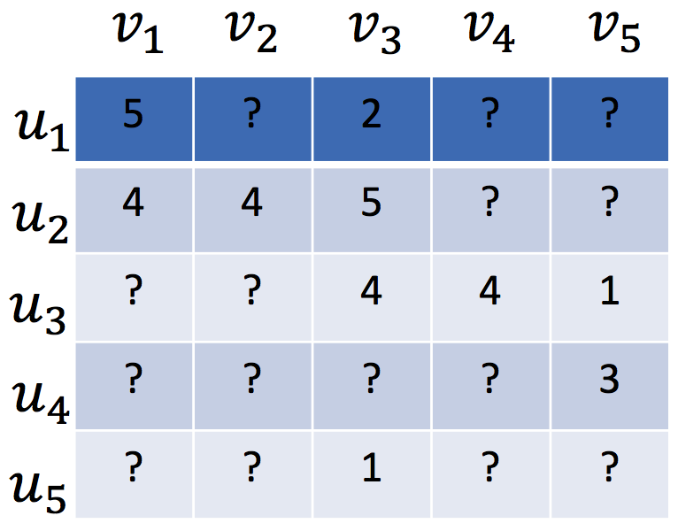
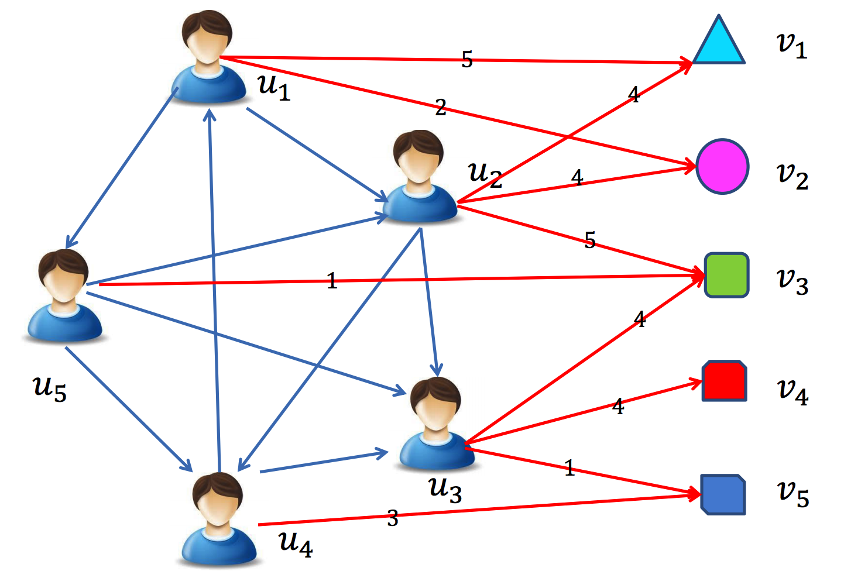
Matrix Factorization
Low-rank MF on the user-item rating matrix R
User preference vector U and Item vector V
High sparsity is the key challenge
If we have auxiliary data…
R
U
Σ
V^{T}
Koren. Factorizatoin Meets the Neighborhood: A Multifaceted Collaborative Filtering Model. KDD, 2008.

Slide 6
Knowledge Transfer: Alleviate the Sparsity
Problem | Bridge | Method
Cross-Source
Cross-Domain
Cross-Platform

Slide 7


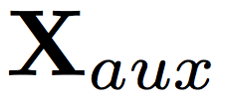
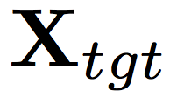
Cross Data Sources
Non-overlapped: Codebook Transfer (CBT)
k_{user} × k_{item}
m movies
q movies
Σ₀
n users
p users
Li et al. Can Movies and Books Collaborate? Cross-Domain Collaborative Filtering for Sparsity Reduction. IJCAI, 2009.

Slide 8
Cross Data Sources
Non-overlapped: Codebook Transfer (CBT)
k_{user} × k_{item}
m books
q movies
Σ₀
n users
p users
Li et al. Can Movies and Books Collaborate? Cross-Domain Collaborative Filtering for Sparsity Reduction. IJCAI, 2009.

Slide 9
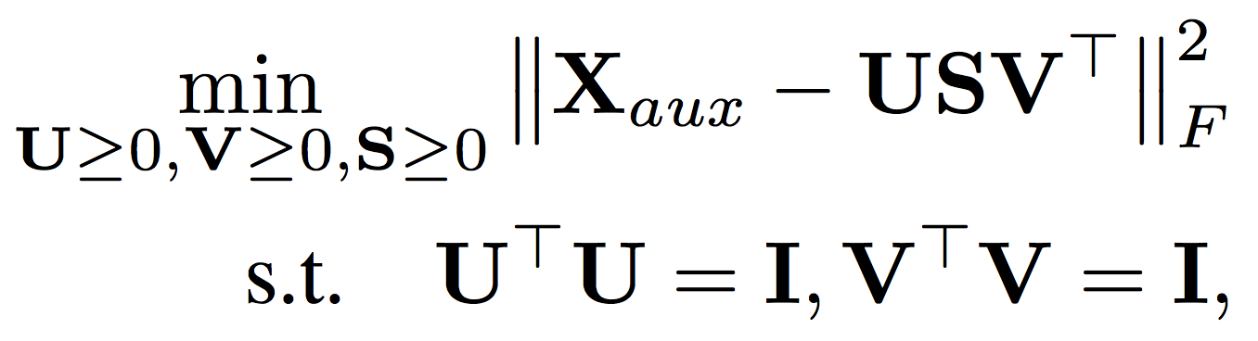
Cross Data Sources
m × l
n × k
Codebook Transfer (CBT)
m books
n users
Codebook = User Group × Item Group
k × l
Li et al. Can Movies and Books Collaborate? Cross-Domain Collaborative Filtering for Sparsity Reduction. IJCAI, 2009.
Notes:
No user nor item can be aligned. Sharing/encoding the patterns. S to B.

Slide 10
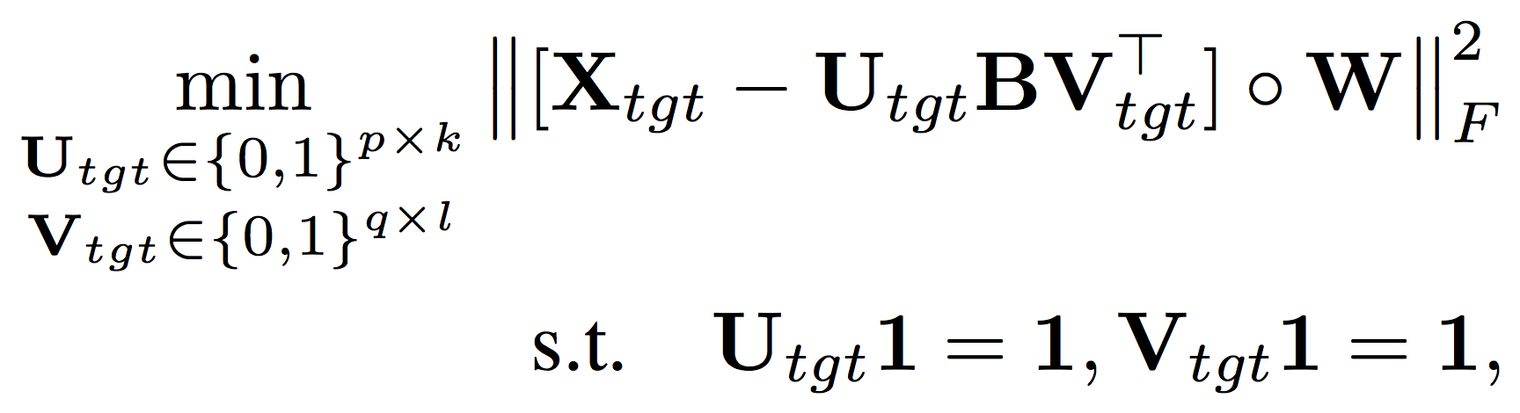
Cross Data Sources
Codebook Transfer (CBT)
Codebook: k × l
q movies
q × l
p × k
p users
Li et al. Can Movies and Books Collaborate? Cross-Domain Collaborative Filtering for Sparsity Reduction. IJCAI, 2009.

Slide 11
Knowledge Transfer: Alleviate the Sparsity
Problem | Bridge | Method
Cross-Source | Non-overlapped User cluster × Item cluster The same latent representation | CBT
Cross-Domain
Cross-Platform

Slide 12
Cross Domains
Fully overlapped
m movies
q books
n users
n users
m movies
p users
Pan et al. Transfer Learning in Collaborative Filtering for Sparsity Reduction. AAAI, 2010.
Notes:
Aligned users or aligned items.

Slide 13
Cross Domains
Coordinate System Transfer (CST)
q movies
U₀
n users
m movies
m movies
V₀^{T}
n users
p users
Pan et al. Transfer Learning in Collaborative Filtering for Sparsity Reduction. AAAI, 2010.

Slide 14
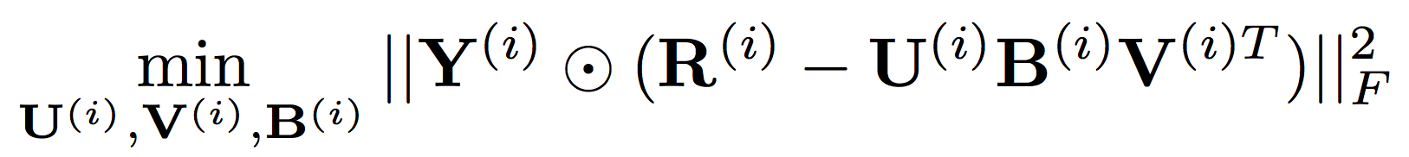
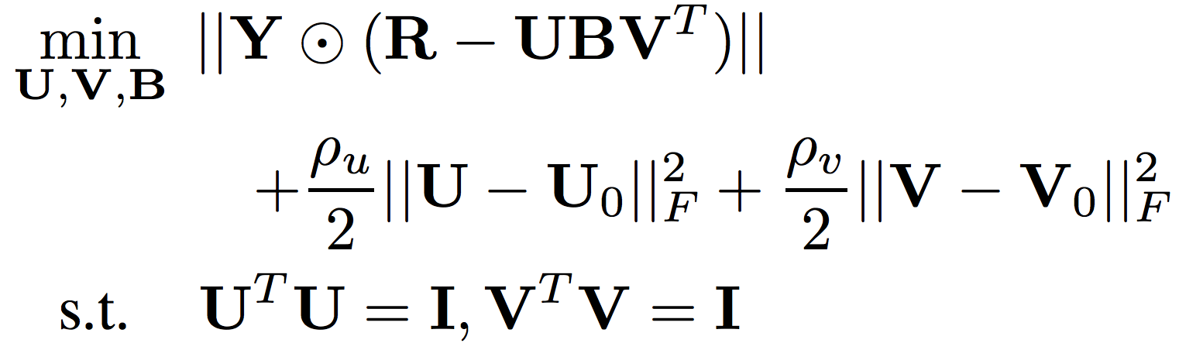
Cross Domains
Coordinate System Transfer (CST)
Auxiliary data:
Target data:
Pan et al. Transfer Learning in Collaborative Filtering for Sparsity Reduction. AAAI, 2010.

Slide 15
Knowledge Transfer: Alleviate the Sparsity
Problem | Bridge | Method
Cross-Source | Non-overlapped User cluster × Item cluster The same latent representation | CBT
Cross-Domain | Fully overlapped users OR Fully overlapped items User vector OR Item vector The same latent representation | CST
Cross-Platform

Slide 16
Cross-Platform: e.g., Facebook+App

Slide 17



Facebook/Twitter/Google Chrome (Auxiliary) Uber/Amazon/Netflix (Target)

Slide 18
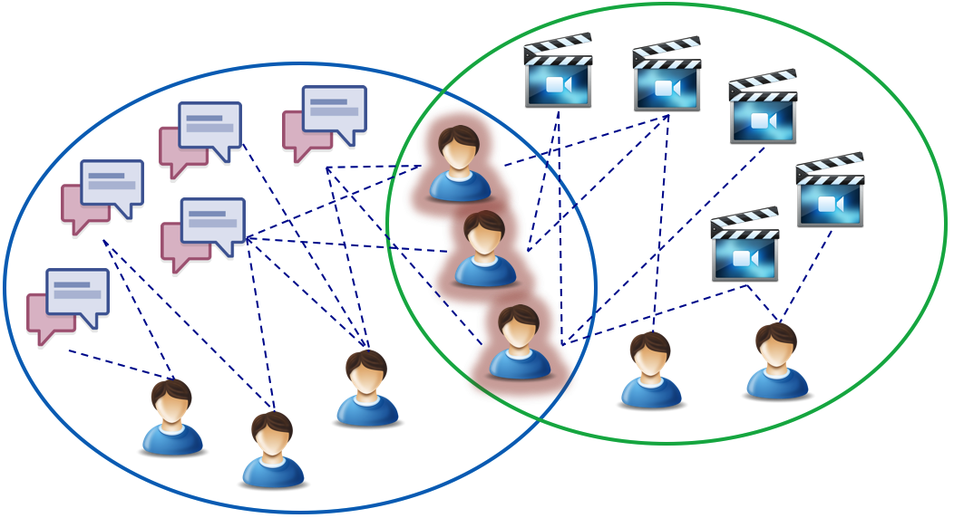
Partially Overlapped Users
B
m products
A
C
n users
q topics
p users

Slide 19
Knowledge Transfer: Alleviate the Sparsity
Problem | Bridge | Method
Cross-Source | Non-overlapped User cluster × Item cluster The same latent representation | CBT
Cross-Domain | Fully overlapped users OR Fully overlapped items User vector OR Item vector The same latent representation | CST
Cross-Platform | Partially overlapped users ? | ?

Slide 20
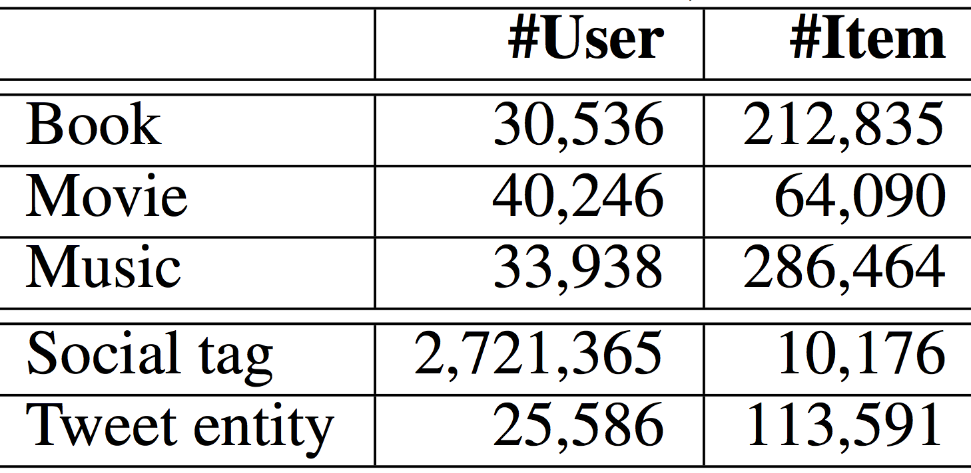
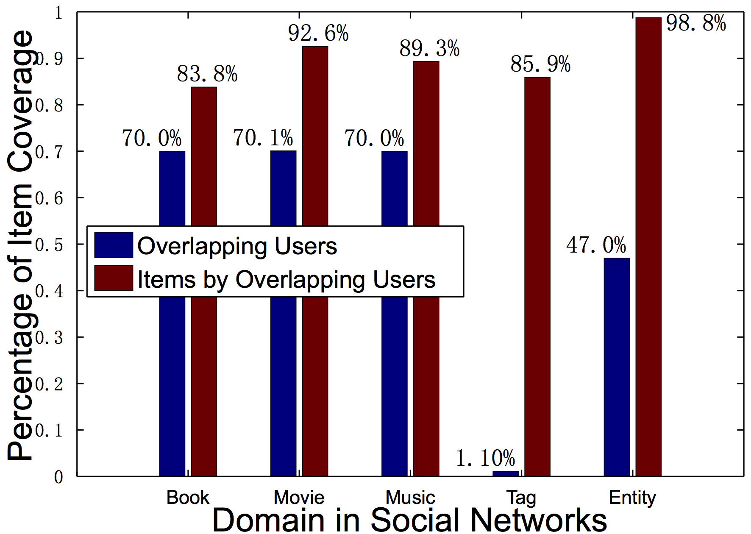
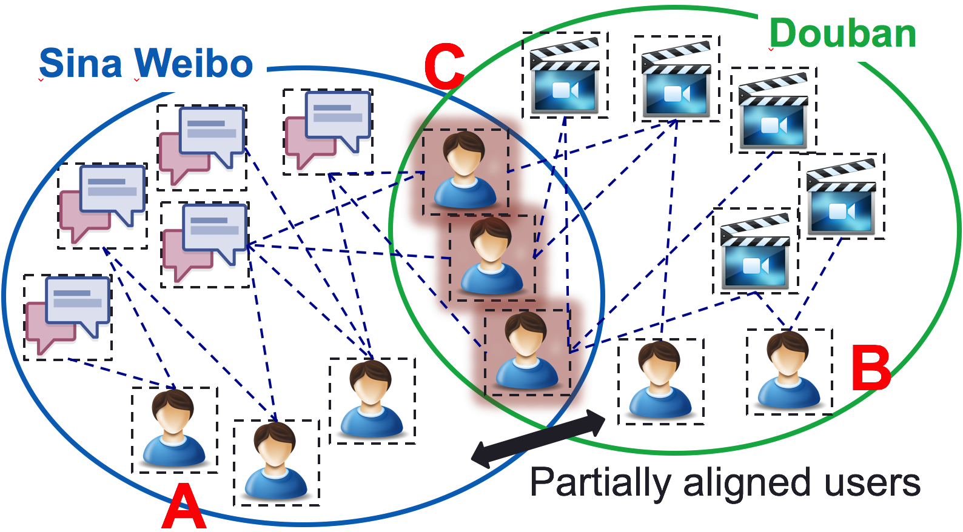
If Overlapped Users Adopted Many Items
1.1% Overlapping Crowd: 85% Coverage

Slide 21
When NO Transfer
Sina Weibo
tags/entities
Douban
movies/books
User set | Weibo tweet entity to Douban movie
 | RMSE | MAP
A | Auxiliary platform data!
C | 0.779 | 0.805
B | 1.439 | 0.640
Sina Weibo
users
A
C
Douban
users
B
User set | Douban book to Weibo social tag
 | RMSE | MAP
A | 0.429 | 0.464
C | 0.267 | 0.666
B | Auxiliary platform data!

Slide 22
Knowledge Transfer: Alleviate the Sparsity
Problem | Bridge | Method
Cross-Source | Non-overlapped User cluster × Item cluster The same latent representation | Codebook
Cross-Domain | Fully overlapped users OR Fully overlapped items User vector OR Item vector The same latent representation | CST
Cross-Platform | Partially overlapped users User vector Different latent representations | XPTrans

Slide 23
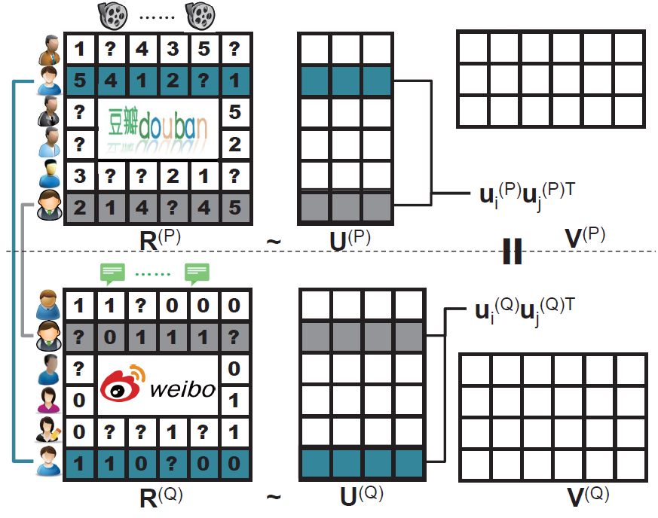
XPTrans: User Representations
Pair-wise
regularization
Overlapping
users

Slide 24
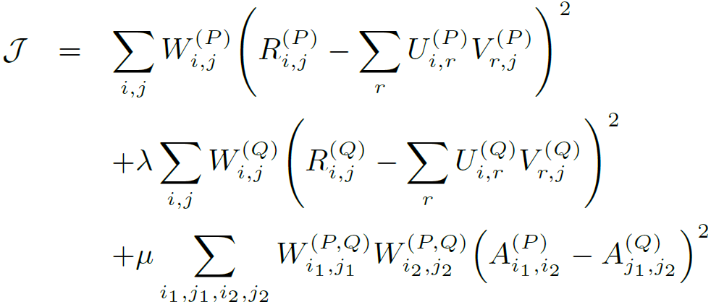
XPTrans: Semi-Supervised Transfer
Objective function
Input
Tgt./Aux. platform P/Q;
Behavior data R^{(P)}/R^{(Q)};
Observation W^{(P)}/W^{(Q)};
Overlapping indicator W^{(P,Q)},
Output
User latent representation U^{(P)}/U^{(Q)};
Item latent representation V^{(P)}/V^{(Q)};
Missing values in R^{(P)}
Target platform
Auxiliary platform
Overlapping user similarity
(Pair-wise regularization)

Slide 25
Leveraging Auxiliary Platform Data
Transfer via the Same
Latent Space
NO Transfer
User set | Weibo tweet entity to Douban movie
 | RMSE | MAP
A | Auxiliary platform data!
C | 0.779 | 0.805
B | 1.439 | 0.640
User set | Weibo tweet entity to Douban movie
 | RMSE | MAP
A
C | 0.757 | 0.811
B | 1.164 (-19%) | 0.702 (+9.7%)
User set | Douban book to Weibo social tag
 | RMSE | MAP
A | 0.429 | 0.464
C | 0.267 | 0.666
B | Auxiliary platform data!
User set | Douban book to Weibo social tag
 | RMSE | MAP
A | 0.411 (-4.2%) | 0.487 (+5.0%)
C | 0.256 | 0.681
B

Slide 26
Leveraging Flexible Representation
Transfer via the Same
Latent Space
Transfer via Different
Latent Spaces
User set | Weibo tweet entity to Douban movie
 | RMSE | MAP
A
C | 0.757 | 0.811
B | 1.164 | 0.702
User set | Weibo tweet entity to Douban movie
 | RMSE | MAP
A
C | 0.715 | 0.821
B | 0.722 (-38%) | 0.820 (+17%)
User set | Douban book to Weibo social tag
 | RMSE | MAP
A | 0.411 | 0.487
C | 0.256 | 0.681
B
User set | Douban book to Weibo social tag
 | RMSE | MAP
A | 0.374 (-11%) | 0.533 (+12%)
C | 0.236 | 0.705
B

Slide 27
Cross-Platform: Where Amazing Happens
Transfer via Different
Latent Spaces
NO Transfer
User set | Weibo tweet entity to Douban movie
 | RMSE | MAP
A | Auxiliary platform data!
C | 0.779 | 0.805
B | 1.439 | 0.640
User set | Weibo tweet entity to Douban movie
 | RMSE | MAP
A
C | 0.715 | 0.821
B | 0.722 | 0.820
User set | Douban book to Weibo social tag
 | RMSE | MAP
A | 0.429 | 0.464
C | 0.267 | 0.666
B | Auxiliary platform data!
User set | Douban book to Weibo social tag
 | RMSE | MAP
A | 0.374 | 0.533
C | 0.236 | 0.705
B

Slide 28
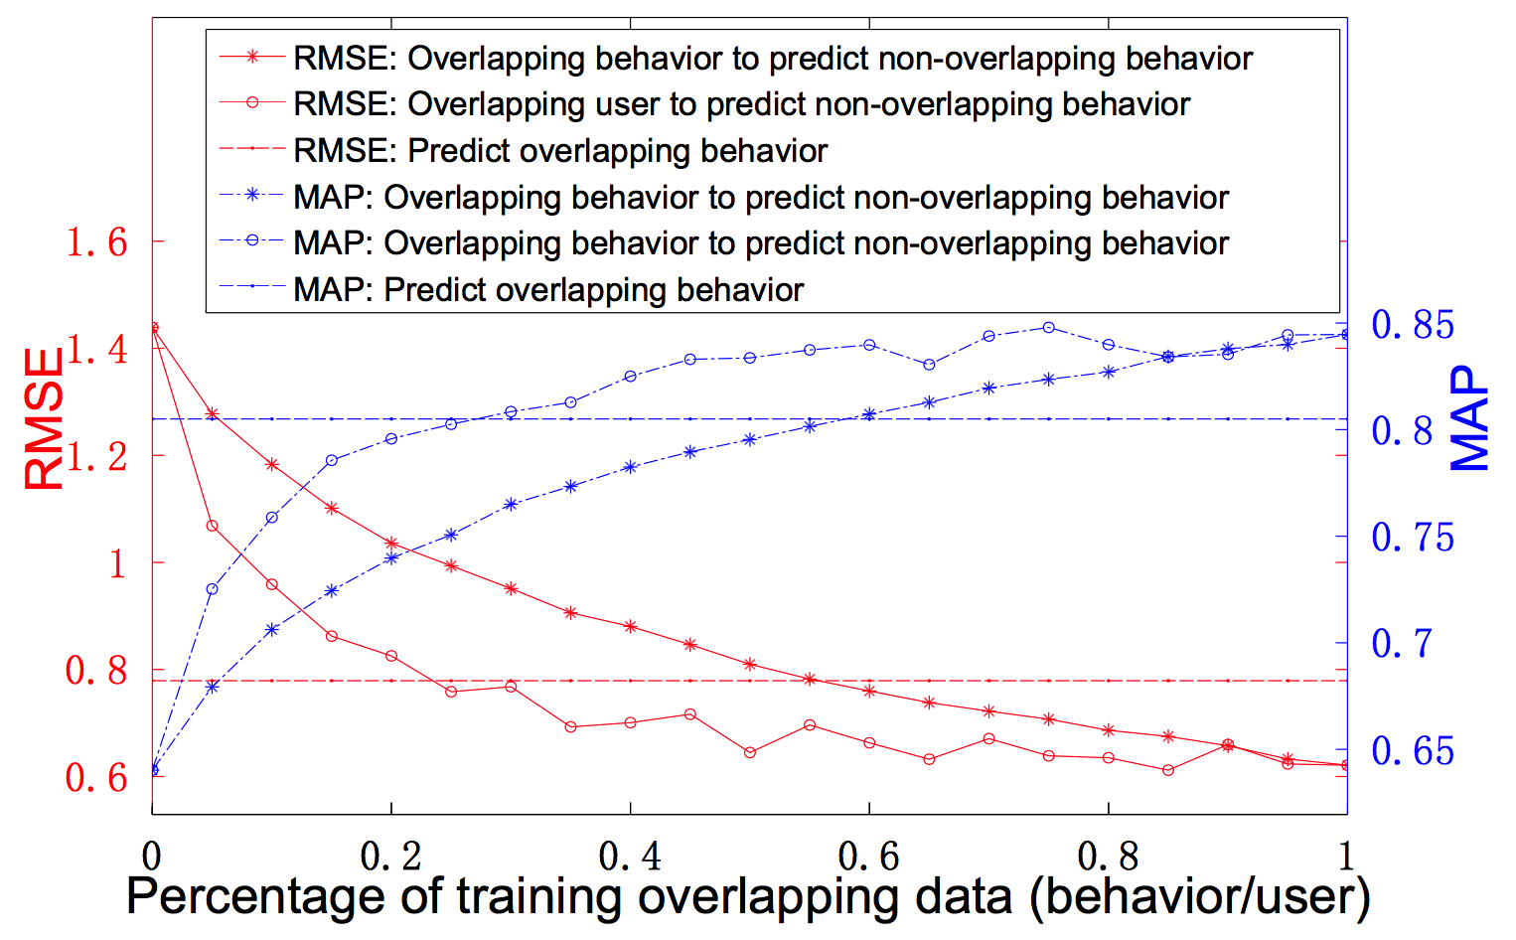
Performance
A→B
C
C
A→B

Slide 29
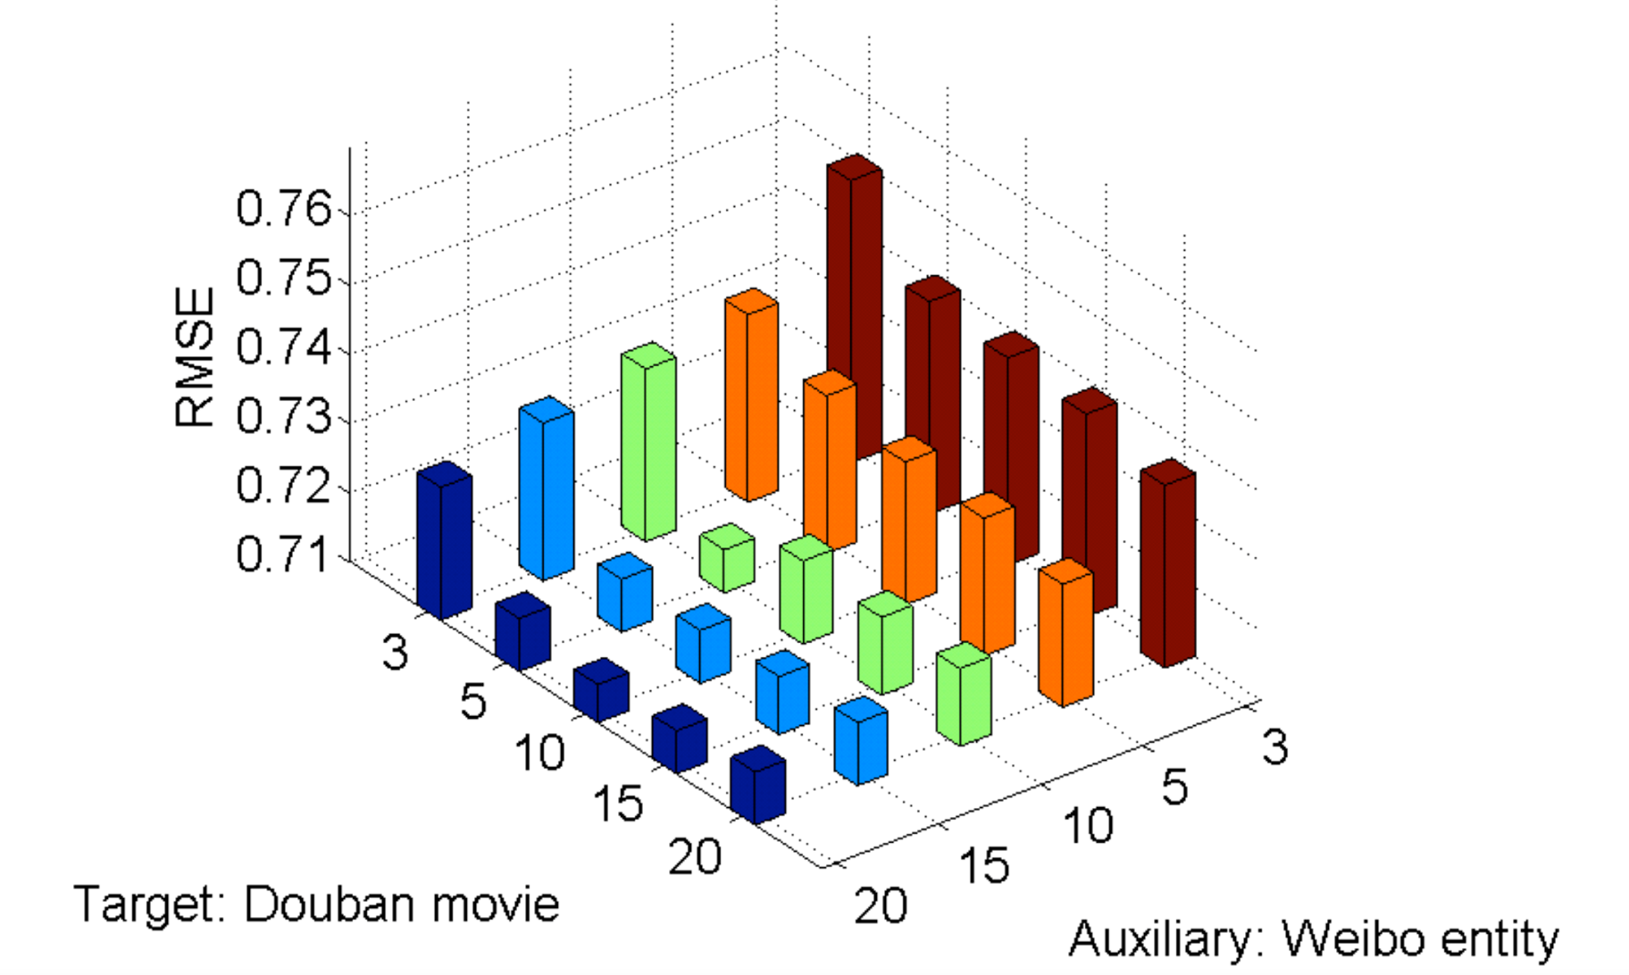
Different Sizes of Latent Space

Slide 30
Discussion 1: Probability of the Overlapping?
p = 0.6
p = 0.7
p = 1.0

Slide 31
Discussion 2: Bridging Items with Semantics?
topics, phrases,
tags…?
m products
n users
q topics
p users

Slide 32
Discussion 3: Bridging Different Behavioral Data Structures?
Facebook
user-message
Uber:
spatio-temporal data
Pinterest:
multimedia data
Amazon:
user-product perchasing
Netflix:
user-movie rating
….
×

Slide 33
Thank you
www.meng-jiang.com

